Slide 1
Voice – Active & Passive
The voice is the quality of a verb that indicates/expresses whether its subject acts or is acted upon ie., whether the subject in the sentence has performed or received the action
E.g., The cat killed the rat.
E.g., The rat was killed by the cat
Verbs have two voices: Active and Passive
The watchman opened the door. (Active Voice – here action performed by the subject expressed by the verb)
The door was opened by the watchman (Passive Voice – here action expressed by the verb is received by the subject)
A sentence with a transitive verb can be changed into passive voice and a sentence with an intransitive verb cannot be changed into passive voice

Slide 2
(Only transitive verbs take objects so they can be transformed into passive constructions. Active sentences containing certain verbs cannot be transformed into passive structures – ‘have’ most important of these)
He has a new car, but not A new car is had by him.
So are verbs like:
resemble mean suit comprise
hold contain lack become
In the following sentences, the verbs are intransitive and hence they do not take objects. Only transitive verbs can take objects
E.g., The audience laughed.
E.g., Birds fly.
Whereas in the sentence ‘The audience enjoyed the jokes’, verb is transitive and hence can be converted into passive : The jokes were enjoyed (by the audience).

Slide 3
Active and passive voices are valid and correct but when used inappropriately can lead to confusing and complex sentences
E.g., She threw the stone.
We submitted the investigation report.
The subject of each sentence performs the action , the main verb describes what the doer or performer is doing
Active voice-most efficient way to construct simple, direct sentences that communicate an action
Passive voice directs the reader’s attention to the thing that experienced the action (the verb) of the sentence –focus of the sentence is on action and not the subject.
E.g., The stone was thrown.
E.g., The investigation report was submitted.

Slide 4
Conversion of Active and Passive voice examples
Rita wrote a letter. (Subject + Verb + Object)
A letter was written by Rita. (Object) + (auxiliary verb) + (past participle) + (by subject).
She cooks food. (Subject + Verb + Object)
The food is cooked by her. (Object) + (auxiliary verb) + (past participle) + (by subject)
Rule 1. Identify the (S+V+O) Subject, Verb and object in the active sentence to convert to passive voice
E.g., Raju designs buildings.
Rule 2.Interchange the object and subject with each other, i.e. object of the active sentence become the subject of the passive sentence.
E.g., The technician repaired the machine.
The machine was repaired by the technician.
Rule 3. In passive voice sometimes the subject is not used, i.e. the subject in passive voice can be omitted if the sentence without it gives enough meaning.

Slide 5
E.g., Milk is sold in litres.
Rule 4. Change the base verb in the active sentence into the past participle ie. third form verb in a passive sentence i.e. preceded by (By, With, to, etc). Base verbs are never used in passive voice sentences
E.g., She knows him.
He is known to her.
Rule 5. While conversion of Active voice sentence to Passive voice sentence, the pronoun used in the sentence also changes in the following manner.
E.g., I inspected the work site.
The work site was inspected by me.
Rule 6. Use the suitable helping or auxiliary verb (is/am/are/was, etc.). The rules for using auxiliary verbs in passive voice sentences are different for each tense.
E.g., They are installing the software.
The software is being installed.

Slide 6
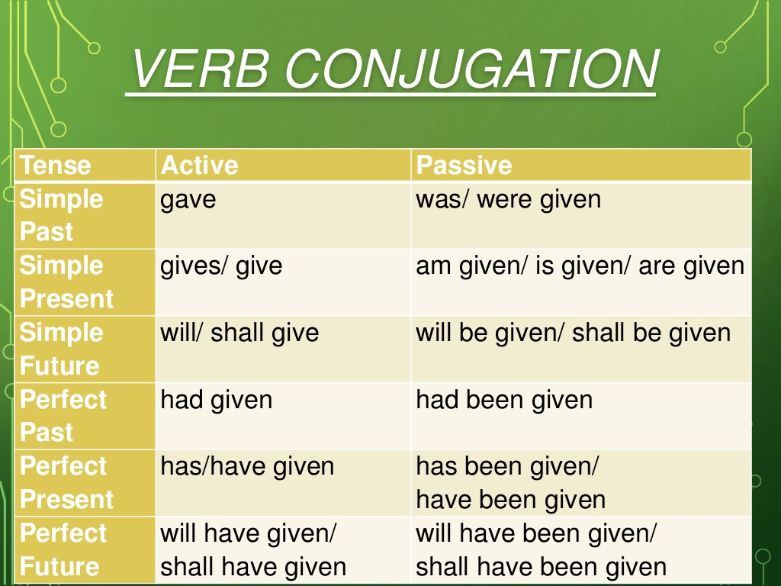

Slide 7
Impersonal Passive
In technical & scientific communication, focus is on conveying data and important information
It is common to avoid personal expressions or statements to make writing more impartial and formal--avoid personal pronouns because it can undermine the objectivity of the writer or distract from important information
Passive construction preferred over active
if one wishes to make his/her writing formal and depersonalized (e.g., It was agreed that the experiment should be carried out under the following conditions…rather than We agreed that the experiment ….)
when the information about the agent is obvious or unimportant (e.g., Extra solvent was added to the tube …instead of The technician added extra solvent ….)

Slide 8
c. you do not know the identity of the agent (e.g., The water pipe was broken in three places … in place of Someone broke the water pipe in three places….)
More examples:
The city was founded in 1806.
The deadline was missed.
Part of the track was broken.
However, used indiscriminately, passive voice/impersonal passive can lead to clumsy and over complicated sentences-it can end up in ambiguity or inaccuracy in written communication
E.g., Difficulty was experienced in obtaining the product in a high state of purity

Slide 9
However passive is used very frequently in scientific and technical writing to avoid distraction from important information and to maintain objectivity and shift focus away from the person doing the action. In technical writing, writers also avoid using personal pronouns.
E.g., The wire was cut. (instead of I cut the wire)
Nominalization – process of turning a verb into a noun
E.g., We analysed the results.
An analysis of the results was made. (inappropriate nominalizations make m the writing more wordy and phrases more sluggish – the sentence will be grammatically correct but distracts from the real action)
Writing with too many nominalizations creates sentences that are difficult to read and overly complex. Result in losing the reader’s attention and understanding.

Slide 10
Active Voice | Impersonal Passive | AVOID: Passive Voice with Nominalization
The team verified the contents of the lab kit. (or “I verified…” in 1st person) | The contents of the lab kit were verified. | A verification of the lab kit contents was carried out.
The team member removed the insulation with a wire stripper. (or “I removed…” in 1st person) | The insulation was removed with a wire stripper. | Removal of the insulation was completed using a wire stripper.

